Slide 1
Replenish the Species
Build your own animals
This work is licensed under the
Creative Commons Attribution-ShareAlike 4.0 International License.
To view a copy of this license, visit http://creativecommons.org/licenses/by-sa/4.0/.
Notes:
Build your own animals

Slide 2
Your task…
Build a next generation animal to replace an extinct species.
Notes:
Build your own animals

Slide 3
Our development process
Gather stories
Release
Estimate
Develop
Signup
Notes:
In the Shaw world, it’s Plan -> Execute -> Sponsor review -> Peer Review (code review)
Build your own animals

Slide 4
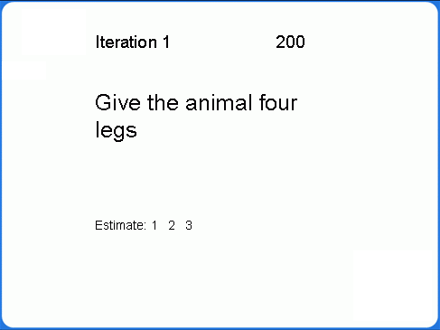
We have everything, right?
Card wall
Other stuff (illities, iteration plans, etc.)
Burndown
Notes:
Build your own animals

Slide 5
Iteration 1
Story re-estimation - 3 minutes
  Act as developers
  Estimate how much effort each story will take
Story selection -3minutes
  Act as the business
  Based on the importance (business value) of each story, select those stories you think you can complete in 4 minutes
Development -4 minutes
  To your Legos!
Testing and acceptance
  Act as the customer
  Test the animal to make sure it meets all the acceptance criteria
  Write bugs on cards
Notes:
Build your own animals

Slide 6
How did it go?
Anything left on card wall?
Adjust the iteration plans
Update the Burndown
Notes:
Build your own animals

Slide 7
Retrospective
Notes:
“Regardless of what we discover, we understand and truly believe that everyone did the best job they could, given what they knew at the time, their skills and abilities, the resources available, and the situation at hand.”
Build your own animals

Slide 8
Iteration 2
Story re-estimation - 3 minutes
  Act as developers
  Estimate how much effort each story will take
Story selection -3minutes
  Act as the business
  Based on the importance (business value) of each story, select those stories you think you can complete in 4 minutes
  Update the card wall
Development -4 minutes
  To your Legos!
Testing and acceptance
  Act as the customer
  Test the animal to make sure it meets all the acceptance criteria
  Write bugs on cards
Notes:
Build your own animals

Slide 9
How did it go?
Anything left on card wall?
Adjust the iteration plans
Update the Burndown
Notes:
Build your own animals

Slide 10
Did things improve
“If you do what you have always done, you will get what you have always got”
Notes:
Build your own animals

Slide 11
Iteration Three
Notes:
Build your own animals

Slide 12
Iteration 3
Story re-estimation - 3 minutes
  Act as developers
  Estimate how much effort each story will take
Story selection -3minutes
  Act as the business
  Based on the importance (business value) of each story, select those stories you think you can complete in 4 minutes
  Update the card wall
Development -4 minutes
  To your Legos!
Testing and acceptance
  Act as the customer
  Test the animal to make sure it meets all the acceptance criteria
  Write bugs on cards
Notes:
Build your own animals

Slide 13
How did it go?
Anything left on card wall?
Adjust the iteration plans
Update the Burndown
Notes:
Build your own animals

Slide 14
Did things improve
“If you do what you have always done, you will get what you have always got”
Notes:
Build your own animals

Slide 15
Did it go well & when will you be done?
Notes:
Build your own animals

Slide 16
How do you know when you’ll be done
What you get done per iteration is called Velocity
Now we have real velocity – is it close to your estimated velocity?
So, look at what’s left and work out how much you can do per iteration (on average)
How many more iterations do you need to finish MMF?
How many more to finish everything?
Notes:
Build your own animals

Slide 17
What did you learn?
Notes:
Build your own animals

Slide 18
Focus on Agility
Accept that we will not know everything right away.
Practice delivering chunks of work incrementally.
Work collaboratively as a whole team.
Notes:
Build your own animals

Slide 19
So what is next?
What are you going to take away from this workshop?
What are you going to do differently tomorrow (and the next day…)?

Slide 20
Agile Lego Game
Thanks for attending!
Notes:
Build your own animals

